Slide 1

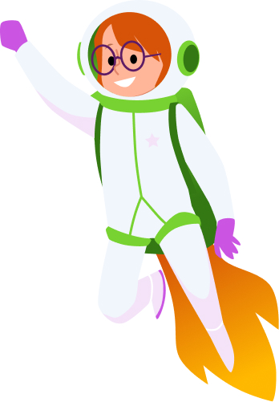
Put your game name here

Slide 2
Our team
Team member | Role
 | Game Designer
 | Artist/Visual Designer
 | Programmer
 | Storyteller
 | Sound and Music Effects
 | Tester(s)

Slide 3
Game overview
What is your game about?
How does the name of your game tell people what the game will be about?
What is this year’s theme?

Slide 4
Game details
What are the goals or objectives of your game?
What does the player do in the game?

Slide 5
Instructions
How do you play your game? (e.g. arrow keys, mouse, space bar)
How can the player move?
How does the player finish the game/level?

Slide 6
Characters/important objects
Are there things to look out for or collect? (e.g. bad guys, keys)
Put pictures of your characters and important objects here

Slide 7
Audio elements
What are the important sounds in your game?
How did you make your sounds and/or music?

Slide 8

Reminder: Steps to success!
I checked these things often while I was building my game to make sure they worked the way I wanted them to:
  The game opens and closes
  Any timers and scoring
  The controls
  The objects
  The sounds
  The levels
  Other ____________________________

Slide 9
Testing
Does your game work? Yes/no
How many people tested your game?
Provide some screenshots or examples of your testers feedback

Slide 10

Reflecting
What changes did you make after your game was tested?
What would you do differently next time?
What are you most proud of?

